Slide 1
Retail Management Application using Salesforce
Team Lead : N. Bhavani
Team Member 1 : K. Mutharasi
Team Member 2 : R. Varshini
Team Member 3 : K. Yamini

Slide 2
Over View
Sales force management is the Soul of the company Establishing a world recognize brand does not only required marketing and advertise efforts, but it also required the sales representatives are in simple words sales force along with all other promotional activities.
Sales Force- Division of a business Responsible for Selling products or services.
Sales force is Linking between Companies and Customer. Therefore, companies have to be careful in designing and structuring salesforce.

Slide 3
Purpose:
1. Increasing profit
2. Time spent developing new accounts or
3. Time spent introducing new products.

Slide 4
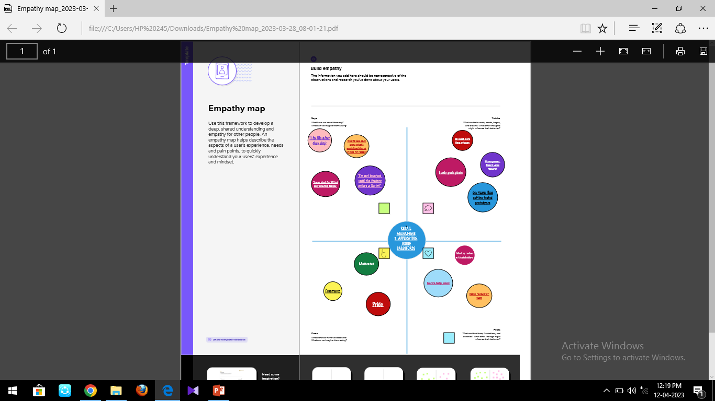
PROBLEM DEFINITION AND DSIGN THINKING

Slide 5
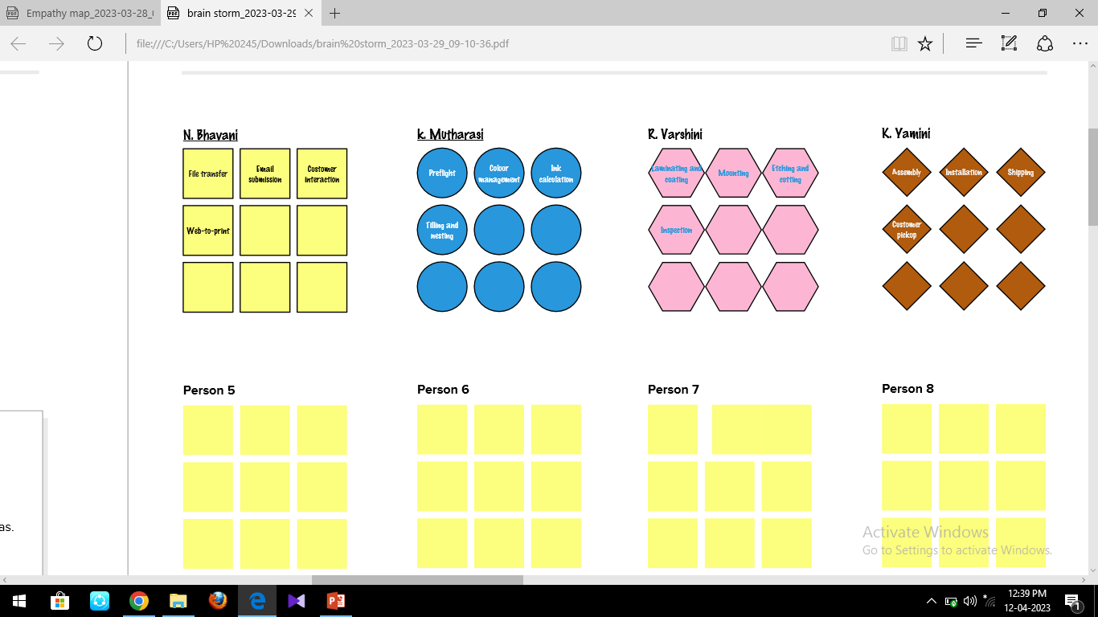
BRAIN STORM

Slide 6
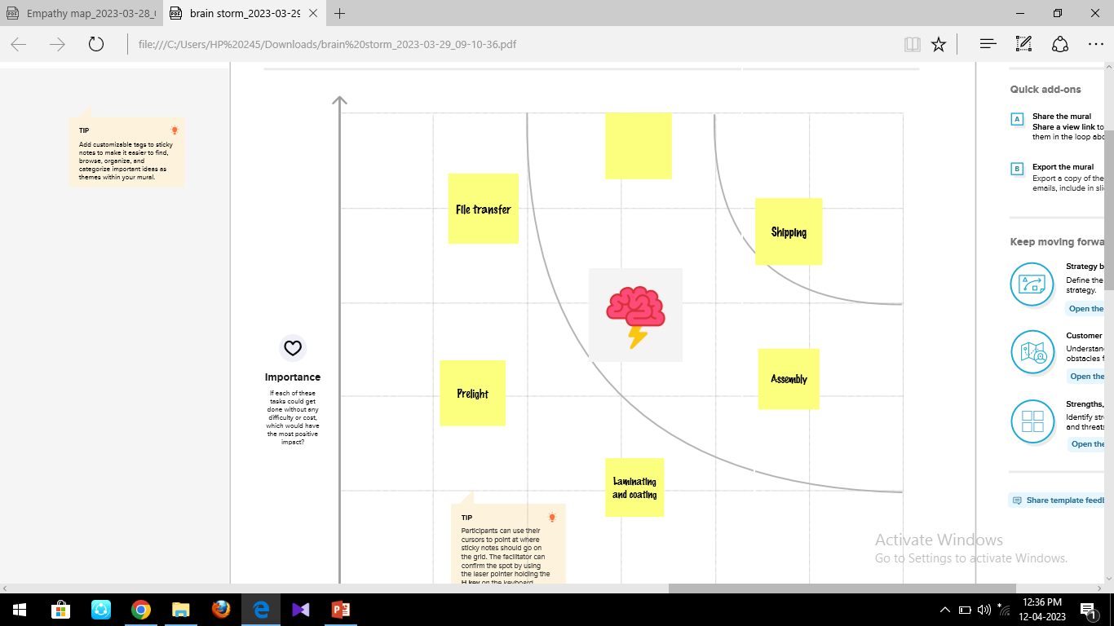
MAP

Slide 7
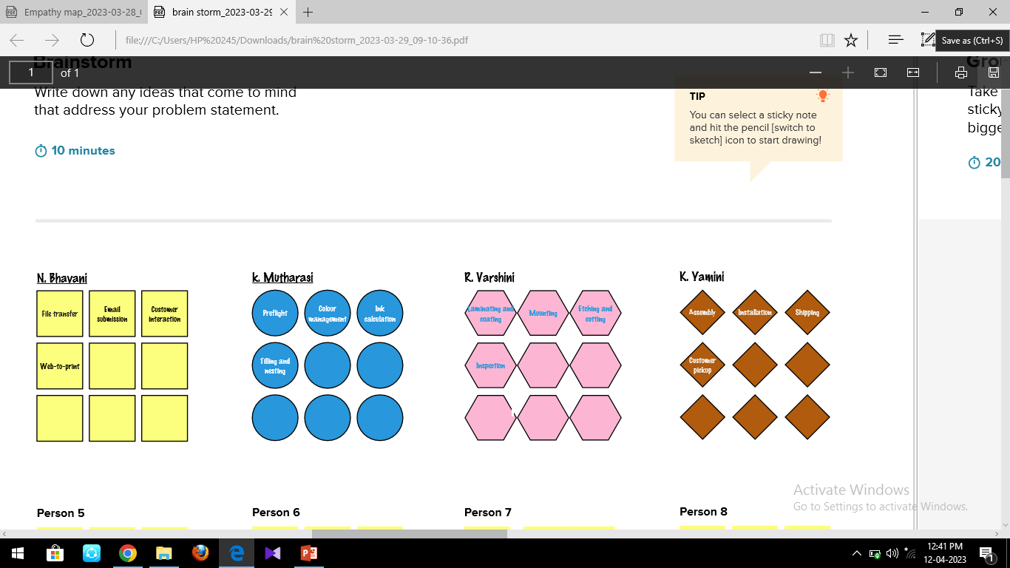
BRAIN STORM
BRAIN STROM

Slide 8
RESULT
Object Name | Field in the object
1. Display/tracking | FIELD LABLE | DATA TYPE
 | Display/tracking | Text
2. Dispatch/tracking | FIELD LABLE | DATA TYPE
 | Dispatch/tracking | Text
3. User | FIELD LABLE | DATA TYPE
 | User | Text
4. Layouts | FIELD LABLE | DATA TYPE
 | Layouts | Text

Slide 9
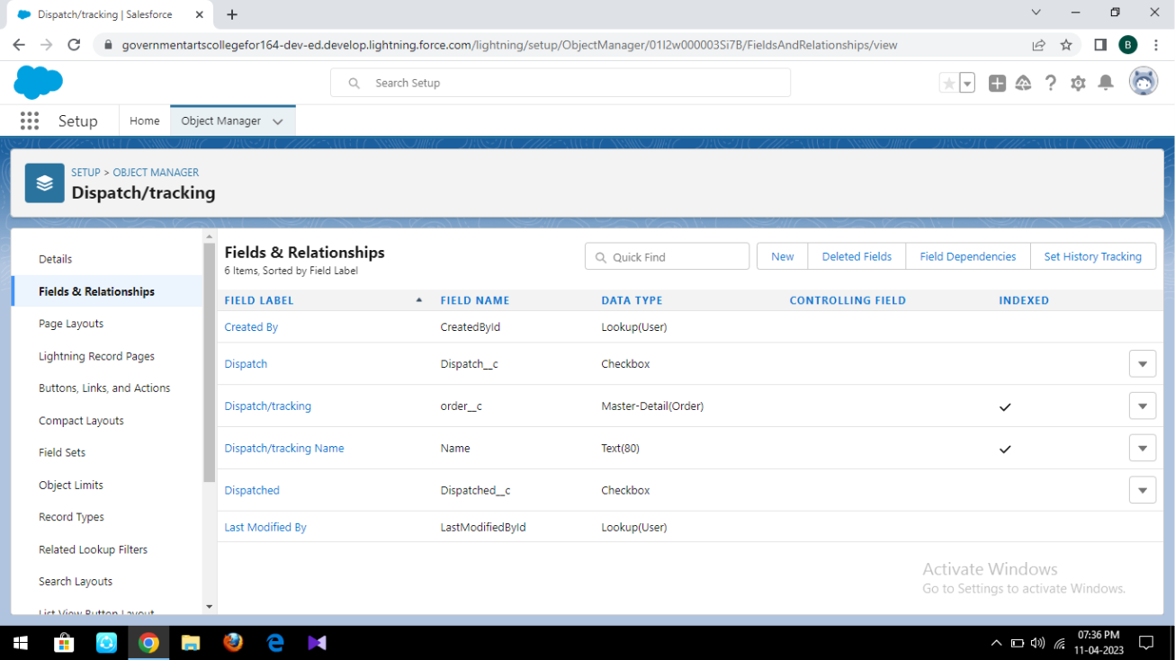
OBJECT
Objects are database tables that permit you to store data that is specific to an organisation.

Slide 10
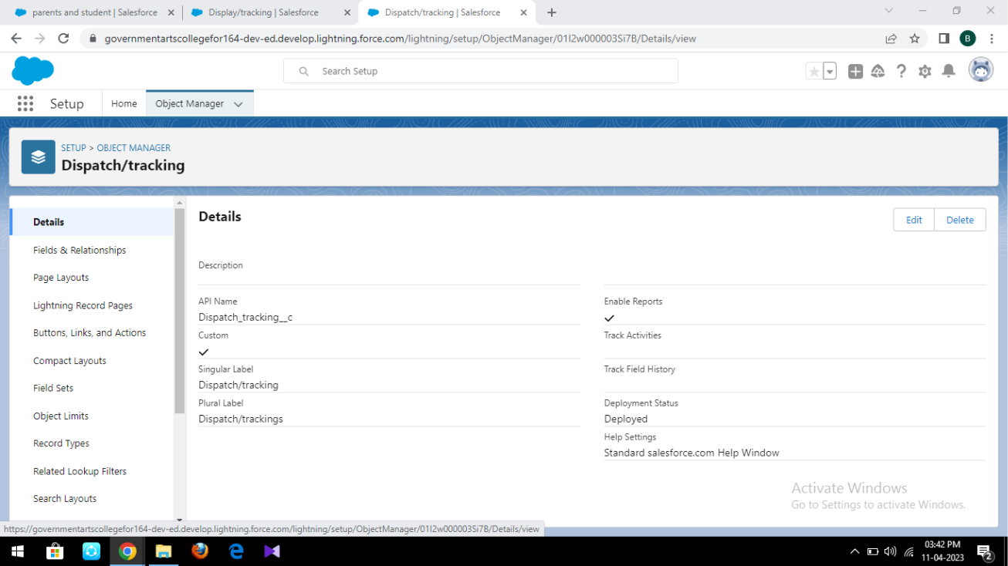
DISPATCH /TRACKING
Dispatched, Excepted date of deliver, Tracking id, Sales order.

Slide 11
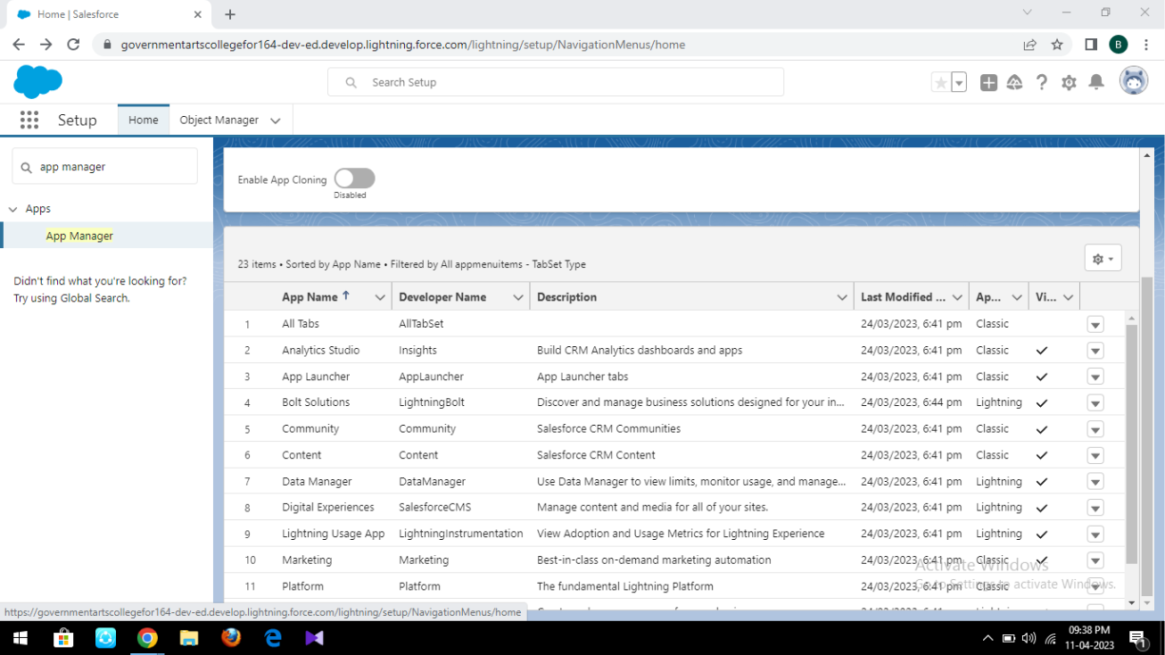
APPLICATION
Apps in salesforce are a group of tabs that help the application function by working together as a unit.

Slide 12
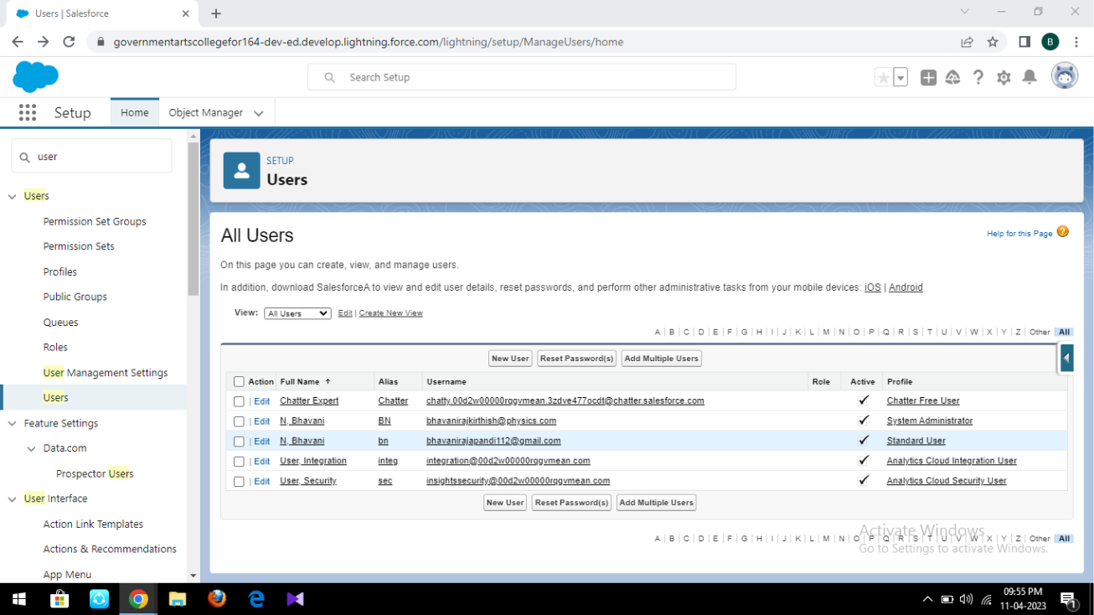
USER
A user is anyone who logs in to salesforce.

Slide 13
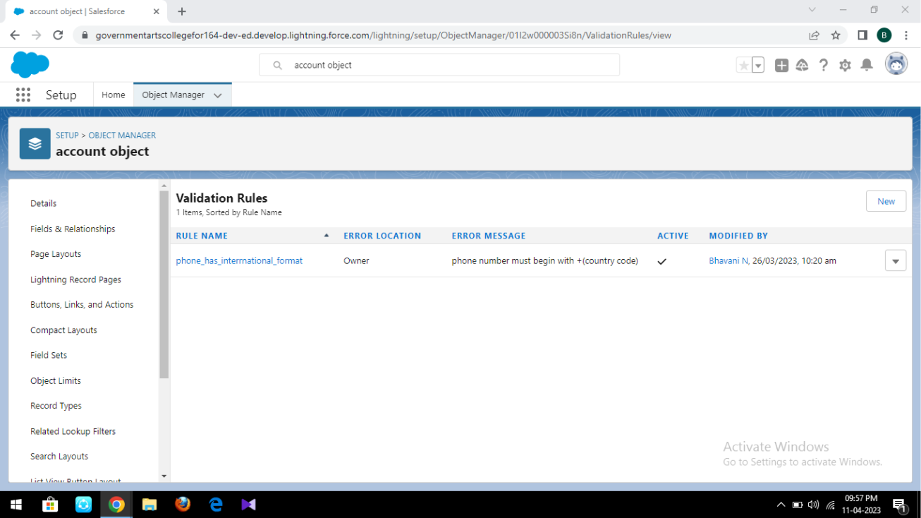
VALIDATION RULES
Notes:
Validation rules verify that the data a user enters in a record meets the standards you specify before the user can save the record.

Slide 14
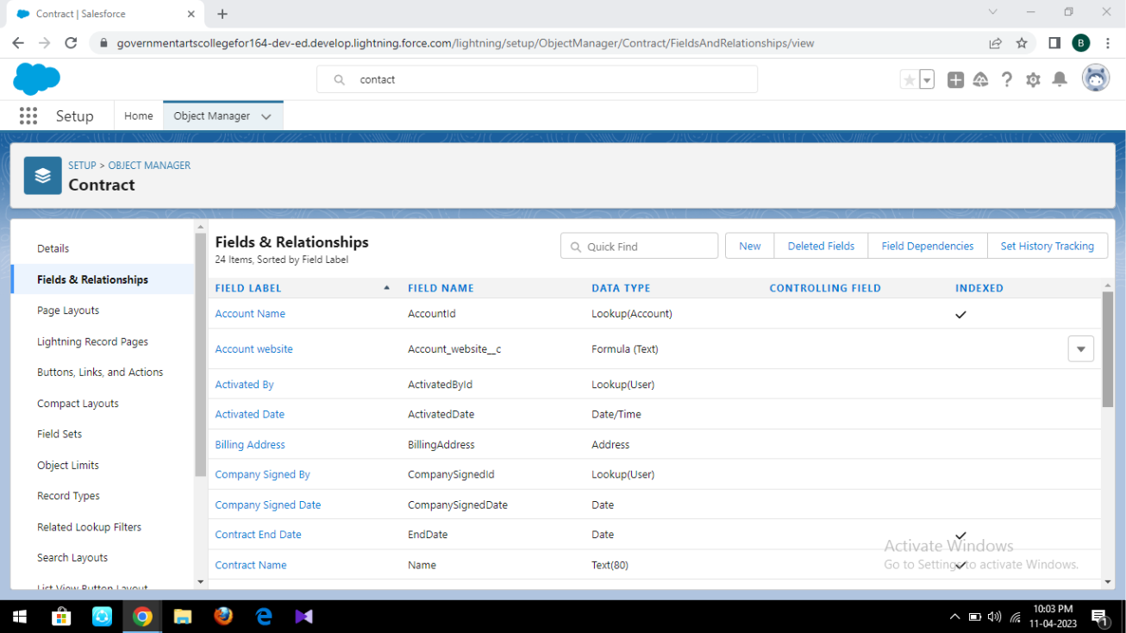
CROSS OBJECT
Notes:
Using an object formula lets you reference merge fields on a master object from a master detail relationship on the detail object.

Slide 15
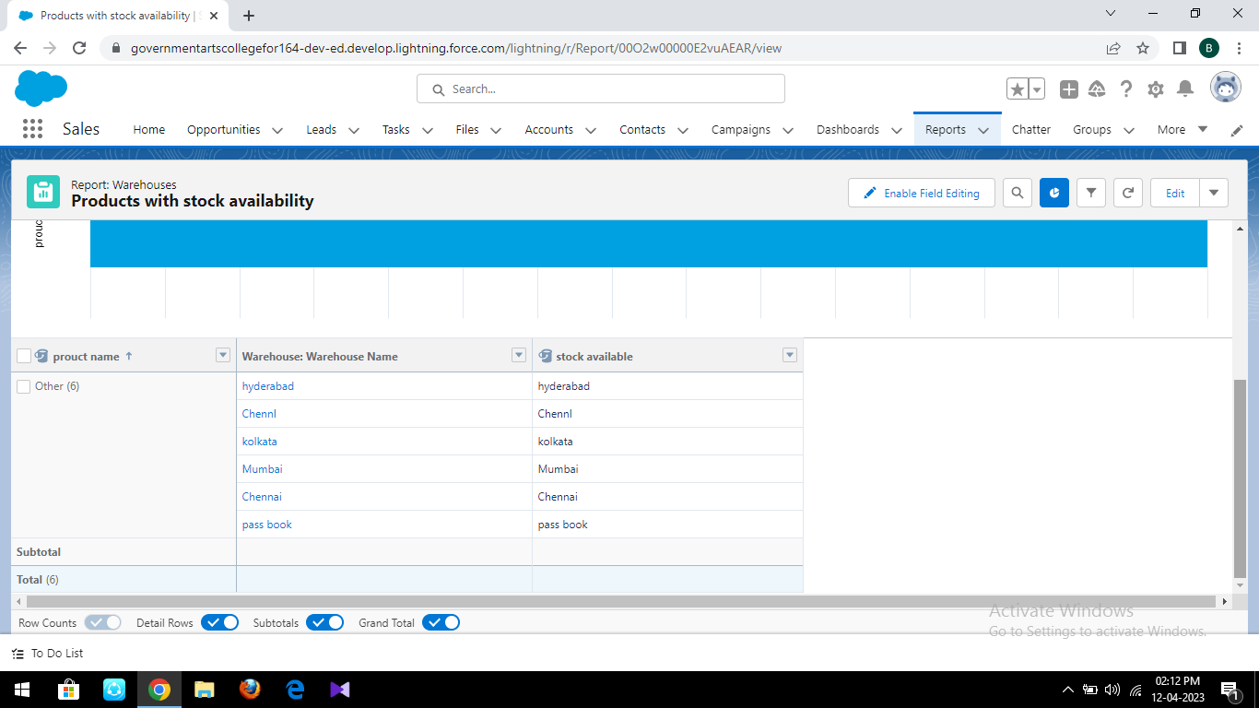
REPORTS
Notes:
A report is a list of records that meet the criteria you define.

Slide 16
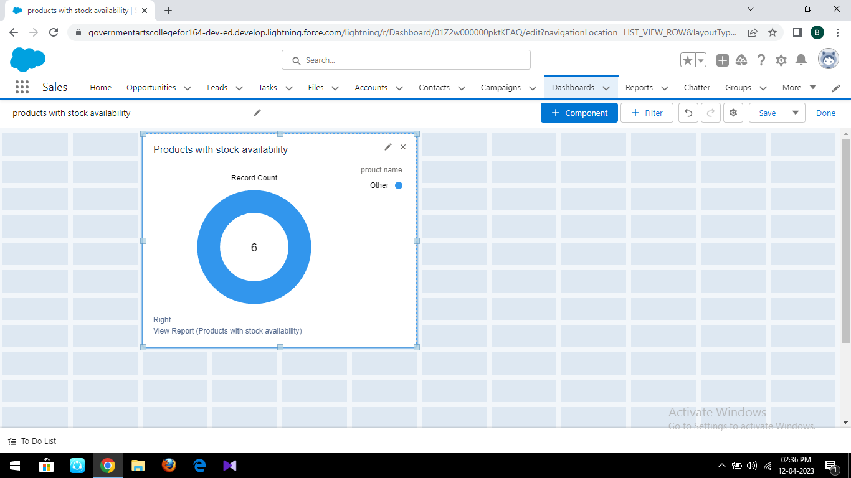
DASHBOARDS
Notes:
Dashboard in salesforce are a graphical representation of reports. It shows data from source reports as visual components.

Slide 17
TRAILHEAD PROFILE
Team leader – https://trailblazer.me/id/brajapandi
Team Member 1 - https://trailblazer.me/id/mmutharasi
Team Member 2- https://trailblazer.me/id/vvarsini
Team Member 3 - https://trailblazer.me/id/ykalimyuthu2

Slide 18
ADVANTAGES
Customer Engagement:
Salesforce provides a unified platform for managing customer interactions, which enables retailers to deliver personalized shopping experiences.
Data Management:
Salesforce provides a centralized repository for managing computer, product, and sales data.
Inventory Management:
Salesforce integrates with leading e-commerce platforms and point –of-sale (POS)systems, makint it easy for retailers to manage their inventory and ensure that products are always in stock.

Slide 19
DISADVANTAGES
Requires More Marketing Costs.
Good Selling Skill Is Required.
High Competition
No Benefit Of Bulk Buying

Slide 20
APPLICATION
Retailing encompasses the business activities involved In selling goods and services to consumers for their personal, family, or household etc.
A CRM product owner has requested create two applications, one is a sales app for sales reps to uses this application and store customers data, and the second application is a service reps/agents to provide support to customers in dealing cases.
To generate business on top of the customers.

Slide 21
CONCLUSION
In conclusion, Salesforce is a powerful platform that can helps retailers meet the demands of the rapidly changing retail landscap.
With its advanced customer engagement, data management, inventory management, onmichannel experience, and collaboration capabilities, salesforce is a must-have for any retail businessf looking to stay ahead of the competition.

Slide 22
FUTURE SCOPE
As the demand for any salesforce jobrole is high, a certification equips you with specialized salesforce requirements.
The right salesforce training props you ahead in a niche area where the scope for carrier growth and salary is sky-high.

